Slide 1
Cluster Analysis: Basic Concepts and Methods
Cluster Analysis: Basic Concepts
Partitioning Methods
Hierarchical Methods
Density-Based Methods
Grid-Based Methods
Evaluation of Clustering
Summary

Slide 2
What is Cluster Analysis?
Cluster: A collection of data objects
  similar (or related) to one another within the same group
  dissimilar (or unrelated) to the objects in other groups
Cluster analysis (or clustering, data segmentation, …)
  Finding similarities between data according to the characteristics found in the data and grouping similar data objects into clusters
Unsupervised learning: no predefined classes (i.e., learning by observations vs. learning by examples: supervised)
Typical applications
  As a stand-alone tool to get insight into data distribution
  As a preprocessing step for other algorithms

Slide 3
Applications of Cluster Analysis
Data reduction
  Summarization: Preprocessing for regression, PCA, classification, and association analysis
  Compression: Image processing: vector quantization
Hypothesis generation and testing
Prediction based on groups
  Cluster & find characteristics/patterns for each group
Finding K-nearest Neighbors
  Localizing search to one or a small number of clusters
Outlier detection: Outliers are often viewed as those “far away” from any cluster

Slide 4
Clustering: Application Examples
Biology: taxonomy of living things: kingdom, phylum, class, order, family, genus and species
Information retrieval: document clustering
Land use: Identification of areas of similar land use in an earth observation database
Marketing: Help marketers discover distinct groups in their customer bases, and then use this knowledge to develop targeted marketing programs
City-planning: Identifying groups of houses according to their house type, value, and geographical location
Earth-quake studies: Observed earth quake epicenters should be clustered along continent faults
Climate: understanding earth climate, find patterns of atmospheric and ocean
Economic Science: market resarch

Slide 5
Basic Steps to Develop a Clustering Task
Feature selection
  Select info concerning the task of interest
  Minimal information redundancy
Proximity measure
  Similarity of two feature vectors
Clustering criterion
  Expressed via a cost function or some rules
Clustering algorithms
  Choice of algorithms
Validation of the results
  Validation test (also, clustering tendency test)
Interpretation of the results
  Integration with applications

Slide 6
Quality: What Is Good Clustering?
A good clustering method will produce high quality clusters
  high intra-class similarity: cohesive within clusters
  low inter-class similarity: distinctive between clusters
The quality of a clustering method depends on
  the similarity measure used by the method
  its implementation, and
  Its ability to discover some or all of the hidden patterns

Slide 7
Measure the Quality of Clustering
Dissimilarity/Similarity metric
  Similarity is expressed in terms of a distance function, typically metric: d(i, j)
  The definitions of distance functions are usually rather different for interval-scaled, boolean, categorical, ordinal ratio, and vector variables
  Weights should be associated with different variables based on applications and data semantics
Quality of clustering:
  There is usually a separate “quality” function that measures the “goodness” of a cluster.
  It is hard to define “similar enough” or “good enough”
    The answer is typically highly subjective

Slide 8
Considerations for Cluster Analysis
Partitioning criteria
  Single level vs. hierarchical partitioning (often, multi-level hierarchical partitioning is desirable)
Separation of clusters
  Exclusive (e.g., one customer belongs to only one region) vs. non-exclusive (e.g., one document may belong to more than one class)
Similarity measure
  Distance-based (e.g., Euclidian, road network, vector) vs. connectivity-based (e.g., density or contiguity)
Clustering space
  Full space (often when low dimensional) vs. subspaces (often in high-dimensional clustering)

Slide 9
Requirements and Challenges
Scalability
  Clustering all the data instead of only on samples
Ability to deal with different types of attributes
  Numerical, binary, categorical, ordinal, linked, and mixture of these
Constraint-based clustering
    User may give inputs on constraints
    Use domain knowledge to determine input parameters
Interpretability and usability
Others
  Discovery of clusters with arbitrary shape
  Ability to deal with noisy data
  Incremental clustering and insensitivity to input order
  High dimensionality

Slide 10
Major Clustering Approaches (I)
Partitioning approach:
  Construct various partitions and then evaluate them by some criterion, e.g., minimizing the sum of square errors
  Typical methods: k-means, k-medoids, etc.,
Hierarchical approach:
  Create a hierarchical decomposition of the set of data (or objects) using some criterion
  Typical methods: Diana, Agnes, BIRCH, CAMELEON
Density-based approach:
  Based on connectivity and density functions
  Typical methods: DBSCAN, OPTICS, DenClue
Grid-based approach:
  based on a multiple-level granularity structure
  Typical methods: STING, WaveCluster, CLIQUE

Slide 11
Major Clustering Approaches (II)
Model-based:
  A model is hypothesized for each of the clusters and tries to find the best fit of that model to each other
  Typical methods: EM, SOM, COBWEB
Frequent pattern-based:
  Based on the analysis of frequent patterns
  Typical methods: p-Cluster
User-guided or constraint-based:
  Clustering by considering user-specified or application-specific constraints
  Typical methods: COD (obstacles), constrained clustering
Link-based clustering:
  Objects are often linked together in various ways
  Massive links can be used to cluster objects: SimRank, LinkClus

Slide 12
Chapter 10. Cluster Analysis: Basic Concepts and Methods
Cluster Analysis: Basic Concepts
Partitioning Methods
Hierarchical Methods
Density-Based Methods
Grid-Based Methods
Evaluation of Clustering
Summary

Slide 13
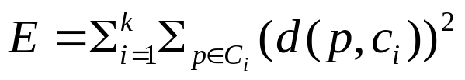
Partitioning Algorithms: Basic Concept
Partitioning method: Partitioning a database D of n objects into a set of k clusters, such that the sum of squared distances is minimized (where c_{i} is the centroid or medoid of cluster C_{i})
Given k, find a partition of k clusters that optimizes the chosen partitioning criterion
  Global optimal: exhaustively enumerate all partitions
  Heuristic methods: k-means and k-medoids algorithms
  k-means (MacQueen’67, Lloyd’57/’82): Each cluster is represented by the center of the cluster
  k-medoids or PAM (Partition around medoids) (Kaufman & Rousseeuw’87): Each cluster is represented by one of the objects in the cluster

Slide 14
The K-Means Clustering Method
Given k, the k-means algorithm is implemented in four steps:
  Partition objects into k nonempty subsets
  Compute seed points as the centroids of the clusters of the current partitioning (the centroid is the center, i.e., mean point, of the cluster)
  Assign each object to the cluster with the nearest seed point
  Go back to Step 2, stop when the assignment does not change

Slide 15





An Example of K-Means Clustering
K=2
Arbitrarily partition objects into k groups
Update the cluster centroids
The initial data set
Loop if needed
Reassign objects
Partition objects into k nonempty subsets
Repeat
  Compute centroid (i.e., mean point) for each partition
  Assign each object to the cluster of its nearest centroid
Until no change
Update the cluster centroids

Slide 16
Comments on the K-Means Method
Strength: Efficient: O(tkn), where n is # objects, k is # clusters, and t is # iterations. Normally, k, t << n.
    Comparing: PAM: O(k(n-k)² ), CLARA: O(ks² + k(n-k))
Comment: Often terminates at a local optimal
Weakness
  Applicable only to objects in a continuous n-dimensional space
    Using the k-modes method for categorical data
    In comparison, k-medoids can be applied to a wide range of data
  Need to specify k, the number of clusters, in advance (there are ways to automatically determine the best k (see Hastie et al., 2009)
  Sensitive to noisy data and outliers

Slide 17

Variations of the K-Means Method
Most of the variants of the k-means which differ in
  Selection of the initial k means
  Dissimilarity calculations
  Strategies to calculate cluster means
Handling categorical data: k-modes
  Replacing means of clusters with modes
  Using new dissimilarity measures to deal with categorical objects
  Using a frequency-based method to update modes of clusters
  A mixture of categorical and numerical data: k-prototype method

Slide 18
What Is the Problem of the K-Means Method?
The k-means algorithm is sensitive to outliers !
  Since an object with an extremely large value may substantially distort the distribution of the data
K-Medoids: Instead of taking the mean value of the object in a cluster as a reference point, medoids can be used, which is the most centrally located object in a cluster
10
10
9
9
8
8
7
7
6
6
5
5
4
4
3
3
2
2
1
1
0
0
1
2
3
4
5
6
7
8
9
10
0
0
1
2
3
4
5
6
7
8
9
10

Slide 19

PAM: A Typical K-Medoids Algorithm
Total Cost = 20
10
9
8
Arbitrary choose k object as initial medoids
Assign each remaining object to nearest medoids
7
6
5
4
3
2
1
0
0
1
2
3
4
5
6
7
8
9
10
K=2
Randomly select a nonmedoid object,O_{ramdom}
Total Cost = 26
Do loop
Until no change
10
10
9
Compute total cost of swapping
9
Swapping O and O_{ramdom}
If quality is improved.
8
8
7
7
6
6
5
5
4
4
3
3
2
2
1
1
0
0
1
2
3
4
5
6
7
8
9
10
0
0
1
2
3
4
5
6
7
8
9
10

Slide 20
Chapter 10. Cluster Analysis: Basic Concepts and Methods
Cluster Analysis: Basic Concepts
Partitioning Methods
Hierarchical Methods
Density-Based Methods
Grid-Based Methods
Evaluation of Clustering
Summary

Slide 21
Hierarchical Clustering
Use distance matrix as clustering criteria. This method does not require the number of clusters k as an input, but needs a termination condition
Step 0
Step 1
Step 2
Step 3
Step 4
agglomerative
(AGNES)
a
a b
b
a b c d e
c
c d e
d
d e
e
divisive
(DIANA)
Step 4
Step 3
Step 2
Step 1
Step 0

Slide 22

AGNES (Agglomerative Nesting)
Introduced in Kaufmann and Rousseeuw (1990)
Implemented in statistical packages, e.g., Splus
Use the single-link method and the dissimilarity matrix
Merge nodes that have the least dissimilarity
Go on in a non-descending fashion
Eventually all nodes belong to the same cluster

Slide 23
Dendrogram: Shows How Clusters are Merged
  Decompose data objects into a several levels of nested partitioning (tree of clusters), called a dendrogram
  A clustering of the data objects is obtained by cutting the dendrogram at the desired level, then each connected component forms a cluster

Slide 24
DIANA (Divisive Analysis)
Introduced in Kaufmann and Rousseeuw (1990)
Implemented in statistical analysis packages, e.g., Splus
Inverse order of AGNES
Eventually each node forms a cluster on its own

Slide 25
Distance between Clusters
X
X
Single link: smallest distance between an element in one cluster and an element in the other, i.e., dist(K_{i}, K_{j}) = min(t_{ip}, t_{jq})
Complete link: largest distance between an element in one cluster and an element in the other, i.e., dist(K_{i}, K_{j}) = max(t_{ip}, t_{jq})
Average: avg distance between an element in one cluster and an element in the other, i.e., dist(K_{i}, K_{j}) = avg(t_{ip}, t_{jq})
Centroid: distance between the centroids of two clusters, i.e., dist(K_{i}, K_{j}) = dist(C_{i}, C_{j})
Medoid: distance between the medoids of two clusters, i.e., dist(K_{i}, K_{j}) = dist(M_{i}, M_{j})
  Medoid: a chosen, centrally located object in the cluster

Slide 26



Centroid, Radius and Diameter of a Cluster (for numerical data sets)
X
Centroid: the “middle” of a cluster
Radius: square root of average distance from any point of the cluster to its centroid
Diameter: square root of average mean squared distance between all pairs of points in the cluster

Slide 27
Extensions to Hierarchical Clustering
Major weakness of agglomerative clustering methods
  Can never undo what was done previously
  Do not scale well: time complexity of at least O(n²), where n is the number of total objects
Integration of hierarchical & distance-based clustering
  BIRCH (1996): uses CF-tree and incrementally adjusts the quality of sub-clusters
  CHAMELEON (1999): hierarchical clustering using dynamic modeling

Slide 28
BIRCH (Balanced Iterative Reducing and Clustering Using Hierarchies)
Zhang, Ramakrishnan & Livny, SIGMOD’96
Incrementally construct a CF (Clustering Feature) tree, a hierarchical data structure for multiphase clustering
  Phase 1: scan DB to build an initial in-memory CF tree (a multi-level compression of the data that tries to preserve the inherent clustering structure of the data)
  Phase 2: use an arbitrary clustering algorithm to cluster the leaf nodes of the CF-tree
Scales linearly: finds a good clustering with a single scan and improves the quality with a few additional scans
Weakness: handles only numeric data, and sensitive to the order of the data record

Slide 29
Probabilistic Hierarchical Clustering
Algorithmic hierarchical clustering
  Nontrivial to choose a good distance measure
  Hard to handle missing attribute values
  Optimization goal not clear: heuristic, local search
Probabilistic hierarchical clustering
  Use probabilistic models to measure distances between clusters
  Generative model: Regard the set of data objects to be clustered as a sample of the underlying data generation mechanism to be analyzed
  Easy to understand, same efficiency as algorithmic agglomerative clustering method, can handle partially observed data
In practice, assume the generative models adopt common distribution functions, e.g., Gaussian distribution or Bernoulli distribution, governed by parameters

Slide 30
Chapter 10. Cluster Analysis: Basic Concepts and Methods
Cluster Analysis: Basic Concepts
Partitioning Methods
Hierarchical Methods
Density-Based Methods
Grid-Based Methods
Evaluation of Clustering
Summary

Slide 31
Density-Based Clustering Methods
Clustering based on density (local cluster criterion), such as density-connected points
Major features:
  Discover clusters of arbitrary shape
  Handle noise
  One scan
  Need density parameters as termination condition
Several interesting studies:
  DBSCAN: Ester, et al. (KDD’96)
  OPTICS: Ankerst, et al (SIGMOD’99).
  DENCLUE: Hinneburg & D. Keim (KDD’98)
  CLIQUE: Agrawal, et al. (SIGMOD’98) (more grid-based)

Slide 32
Density-Based Clustering: Basic Concepts
Two parameters:
  Eps: Maximum radius of the neighbourhood
  MinPts: Minimum number of points in an Eps-neighbourhood of that point
N_{Eps}(q): {p belongs to D | dist(p,q) ≤ Eps}
Directly density-reachable: A point p is directly density-reachable from a point q w.r.t. Eps, MinPts if
  p belongs to N_{Eps}(q)
  core point condition:
  |N_{Eps} (q)| ≥ MinPts
p
MinPts = 5
Eps = 1 cm
q

Slide 33
Density-Reachable and Density-Connected
Density-reachable:
  A point p is density-reachable from a point q w.r.t. Eps, MinPts if there is a chain of points p₁, …, p_{n}, p₁ = q, p_{n} = p such that p_{i+1} is directly density-reachable from p_{i}
Density-connected
  A point p is density-connected to a point q w.r.t. Eps, MinPts if there is a point o such that both, p and q are density-reachable from o w.r.t. Eps and MinPts
p
p₁
q
p
q
o

Slide 34
DBSCAN: Density-Based Spatial Clustering of Applications with Noise
Relies on a density-based notion of cluster: A cluster is defined as a maximal set of density-connected points
Discovers clusters of arbitrary shape in spatial databases with noise
Outlier
Border
Eps = 1cm
MinPts = 5
Core

Slide 35
DBSCAN: The Algorithm
Arbitrary select a point p
Retrieve all points density-reachable from p w.r.t. Eps and MinPts
If p is a core point, a cluster is formed
If p is a border point, no points are density-reachable from p and DBSCAN visits the next point of the database
Continue the process until all of the points have been processed
If a spatial index is used, the computational complexity of DBSCAN is O(nlogn), where n is the number of database objects. Otherwise, the complexity is O(n²)

Slide 36



DBSCAN: Sensitive to Parameters
DBSCAN online Demo:
http://webdocs.cs.ualberta.ca/~yaling/Cluster/Applet/Code/Cluster.html

Slide 37
OPTICS: A Cluster-Ordering Method (1999)
OPTICS: Ordering Points To Identify the Clustering Structure
  Ankerst, Breunig, Kriegel, and Sander (SIGMOD’99)
  Produces a special order of the database wrt its density-based clustering structure
  This cluster-ordering contains info equiv to the density-based clusterings corresponding to a broad range of parameter settings
  Good for both automatic and interactive cluster analysis, including finding intrinsic clustering structure
  Can be represented graphically or using visualization techniques

Slide 38
OPTICS: Some Extension from DBSCAN
Index-based: k = # of dimensions, N: # of points
  Complexity: O(N*logN)
Core Distance of an object p: the smallest value ε such that the ε-neighborhood of p has at least MinPts objects
  Let N_{ε}(p): ε-neighborhood of p, ε is a distance value
  Core-distance_{ε, MinPts}(p) = Undefined if card(N_{ε}(p)) < MinPts
      MinPts-distance(p), otherwise
Reachability Distance of object p from core object q is the min radius value that makes p density-reachable from q
    Reachability-distance_{ε, MinPts}(p, q) =
      Undefined if q is not a core object
      max(core-distance(q), distance (q, p)), otherwise

Slide 39
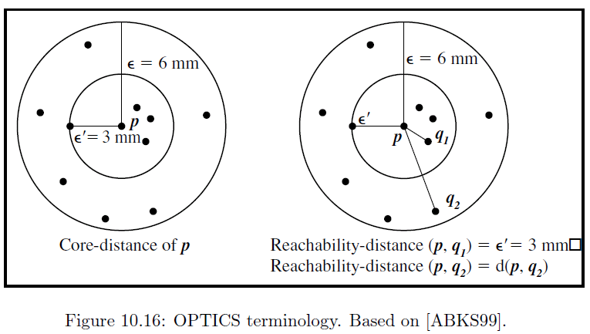
Core Distance & Reachability Distance

Slide 40


Reachability-distance
undefined
‘
Cluster-order of the objects

Slide 41




Density-Based Clustering: OPTICS & Applications demo: http://www.dbs.informatik.uni-muenchen.de/Forschung/KDD/Clustering/OPTICS/Demo

Slide 42



DENCLUE: Using Statistical Density Functions
DENsity-based CLUstEring by Hinneburg & Keim (KDD’98)
Using statistical density functions:
Major features
  Solid mathematical foundation
  Good for data sets with large amounts of noise
  Allows a compact mathematical description of arbitrarily shaped clusters in high-dimensional data sets
  Significant faster than existing algorithm (e.g., DBSCAN)
  But needs a large number of parameters
total influence on x
influence of y on x
gradient of x in the direction of x_{i}

Slide 43
Denclue: Technical Essence
Uses grid cells but only keeps information about grid cells that do actually contain data points and manages these cells in a tree-based access structure
Influence function: describes the impact of a data point within its neighborhood
Overall density of the data space can be calculated as the sum of the influence function of all data points
Clusters can be determined mathematically by identifying density attractors
Density attractors are local maximal of the overall density function
Center defined clusters: assign to each density attractor the points density attracted to it
Arbitrary shaped cluster: merge density attractors that are connected through paths of high density (> threshold)

Slide 44



Density Attractor

Slide 45

Center-Defined and Arbitrary

Slide 46
Chapter 10. Cluster Analysis: Basic Concepts and Methods
Cluster Analysis: Basic Concepts
Partitioning Methods
Hierarchical Methods
Density-Based Methods
Grid-Based Methods
Evaluation of Clustering
Summary

Slide 47
Determine the Number of Clusters
Empirical method
  # of clusters: k ≈√n/2 for a dataset of n points, e.g., n = 200, k = 10
Elbow method
  Use the turning point in the curve of sum of within cluster variance w.r.t the # of clusters
Cross validation method
  Divide a given data set into m parts
  Use m – 1 parts to obtain a clustering model
  Use the remaining part to test the quality of the clustering
    E.g., For each point in the test set, find the closest centroid, and use the sum of squared distance between all points in the test set and the closest centroids to measure how well the model fits the test set
  For any k > 0, repeat it m times, compare the overall quality measure w.r.t. different k’s, and find # of clusters that fits the data the best

Slide 48
Measuring Clustering Quality
3 kinds of measures: External, internal and relative
External: supervised, employ criteria not inherent to the dataset
  Compare a clustering against prior or expert-specified knowledge (i.e., the ground truth) using certain clustering quality measure
Internal: unsupervised, criteria derived from data itself
  Evaluate the goodness of a clustering by considering how well the clusters are separated, and how compact the clusters are, e.g., Silhouette coefficient
Relative: directly compare different clusterings, usually those obtained via different parameter settings for the same algorithm

Slide 49
Measuring Clustering Quality: External Methods
Clustering quality measure: Q(C, T), for a clustering C given the ground truth T
Q is good if it satisfies the following 4 essential criteria
  Cluster homogeneity: the purer, the better
  Cluster completeness: should assign objects belong to the same category in the ground truth to the same cluster
  Rag bag: putting a heterogeneous object into a pure cluster should be penalized more than putting it into a rag bag (i.e., “miscellaneous” or “other” category)
  Small cluster preservation: splitting a small category into pieces is more harmful than splitting a large category into pieces

Slide 50
Some Commonly Used External Measures
Matching-based measures
  Purity, maximum matching, F-measure
Entropy-Based Measures
  Conditional entropy, normalized mutual information (NMI), variation of information
Pair-wise measures
  Four possibilities: True positive (TP), FN, FP, TN
  Jaccard coefficient, Rand statistic, Fowlkes-Mallow measure
Correlation measures
  Discretized Huber static, normalized discretized Huber static
Ground truth partitioning T₁
T₂
Cluster C₁
Cluster C₂

Slide 51
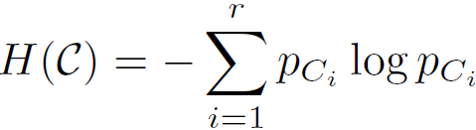

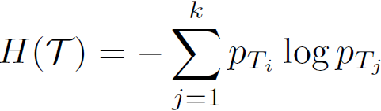
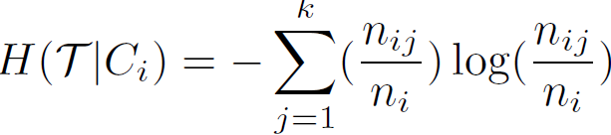
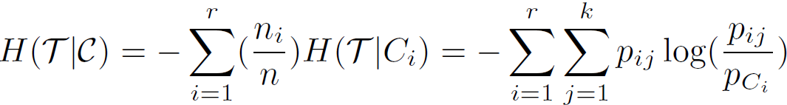

Entropy-Based Measure (I): Conditional Entropy
Entropy of clustering C:
Entropy of partitioning T:
Entropy of T w.r.t. cluster C_{i}:
Conditional entropy of T
  w.r.t. clustering C:
  The more a cluster’s members are split into different partitions, the higher the conditional entropy
  For a perfect clustering, the conditional entropy value is 0, where the worst possible conditional entropy value is log k

Slide 52
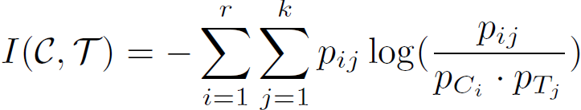

Entropy-Based Measure (II): Normalized mutual information (NMI)
Mutual information: quantify the amount of shared info between the clustering C and partitioning T:
  It measures the dependency between the observed joint probability p_{ij} of C and T, and the expected joint probability p_{Ci} * p_{Tj} under the independence assumption
  When C and T are independent, p_{ij} = p_{Ci} * p_{Tj}, I(C, T) = 0. However, there is no upper bound on the mutual information
Normalized mutual information (NMI)
    Value range of NMI: [0,1]. Value close to 1 indicates a good clustering

Slide 53
Summary
Cluster analysis groups objects based on their similarity and has wide applications
Measure of similarity can be computed for various types of data
Clustering algorithms can be categorized into partitioning methods, hierarchical methods, density-based methods, grid-based methods, and model-based methods
K-means and K-medoids algorithms are popular partitioning-based clustering algorithms
Birch and Chameleon are interesting hierarchical clustering algorithms, and there are also probabilistic hierarchical clustering algorithms
DBSCAN, OPTICS, and DENCLU are interesting density-based algorithms
STING and CLIQUE are grid-based methods, where CLIQUE is also a subspace clustering algorithm
Quality of clustering results can be evaluated in various ways

